Slide 1
SINUS AND FISTULA
Dr. Varun. S
Dept. of Surgery
SKHMC

Slide 2
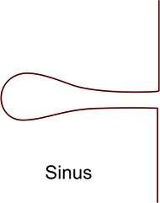
DEFINITION
SINUS:
Blind track lined by granulation tissue leading from epithelial surface down into the tissues.
Latin: Hollow (or) a bay

Slide 3
C AUSES
CONGENITAL
Preauricular sinus
ACQUIRED
TB sinus Pilonidal sinus
Median mental sinus Actinomycosis

Slide 4


FISTULA:
ABNORMAL communication between lumen of one viscus and lumen of another (INTERNAL FISTULA)
(or)
between lumen of one hollow viscus to the exterior (EXTERNAL FISTULA)
(or)
between any two vessels

Slide 5
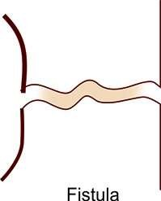
Latin : flute (or) a pipe (or) a tube
.

Slide 6
CAUSES
CONGENITAL
Branchial fistula
Tracheo-esophageal
Umbilical
Congenital AV fistula
Thyroglossal fistula
ACQUIRED
Traumatic
Inflammatory
Malignancy
Iatrogenic

Slide 7
ACQUIRED
TRAUMATIC:
  following surgery : eg., intestinal fistulas
(faecal,biliary,pancreatic)
  following instrumental delivery (or) difficult labour
e.g., vesicovaginal,rectovaginal, ureterovaginal fistula

Slide 8
Intestinal actinomycosis, TB
II. INFLAMMATORY:
III. MALIGNANCY:
when growth of one organ penetrates into the nearby organ.
e.g., Rectovesical fistula in carcinoma rectum
IV. IATROGENIC:
Cimino fistula- AVF for hemodialysis
ECK fistula- to treat esophageal varices in portal HTN

Slide 9
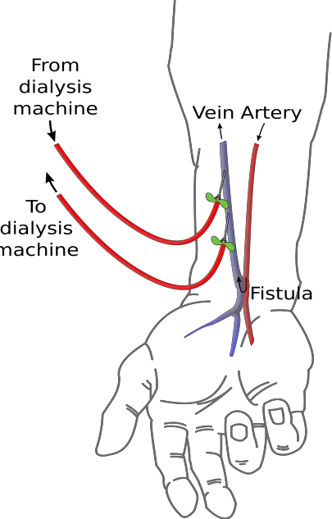
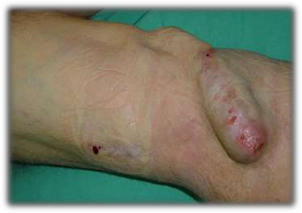
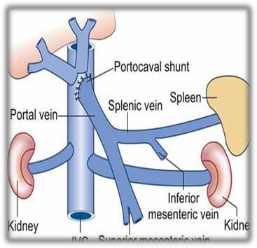

Slide 10
FISTULA
EXTERNAL
Orocutaneous
Enterocutaneous
Appendicular
Thyroglossal
Branchial
INTERNAL
Tracheo-esophageal
Colovesical
Rectovesical
AVF
Cholecystoduodenal

Slide 11
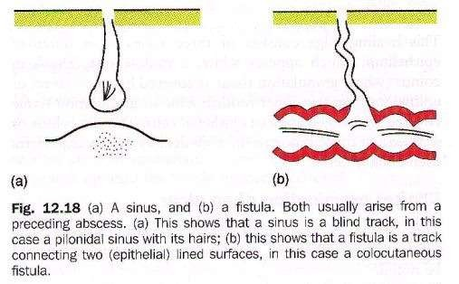
.

Slide 12
Causes for persistence of sinus (or) fistula
Presence of a foreign body. e.g., suture material
Presence of necrotic tissue underneath. e.g.,sequestrum
Insufficient (or) non-dependent drainage. e.g., TB sinus
Distal obstruction. e.g., faecal (or) biliary fistula
Persistent drainage like urine/faeces/CSF
Lack of rest
[contd.]

Slide 13
Epithelialisation (or) endothelisation of the track. e.g., AVF
Malignancy.
Dense fibrosis
Irradiation
Malnutrition
Specific causes. e.g., TB, actinomycosis
Ischemia
Drugs. e.g., steroids
Interference by the patient

Slide 14
PATHOPHYSIOLOGY
CONGENITAL:
Arise from remnants of embryonic ducts that persist instead of being obliterated and disappearing completely during embryonic development.
e.g., pre-auricular sinus, branchial fistula, TOF, congenital AVF.

Slide 15
ACQUIRED :
Usually secondary to presence of foreign body, necrotic tissue in affected area (or) microbial infection (or) following inadequate drainage of abscess.
e.g., perianal abscess when bursts spontaneously into skin forming a sinus and when bursts into both skin and anal canal forming a fistula.

Slide 16
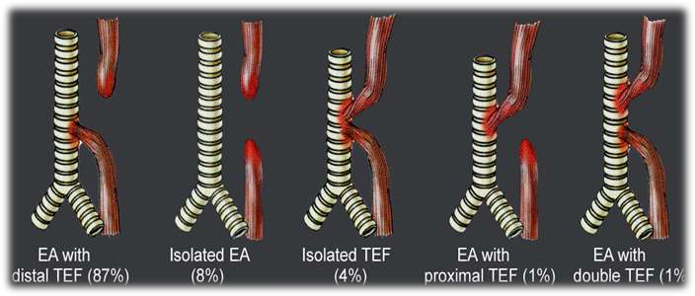
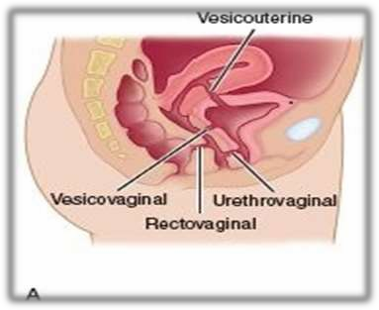

Slide 17
CLINICAL FEATURES
Usually asymptomatic but when infected manifest as-
Recurrent/ persistent discharge.
Pain.
Constitutional symptoms if any deep seated origin.

Slide 18
CLINICAL EXAMINATION
INSPECTION:
1. Location: usually gives diagnosis in most of the cases.
pre-auricular- root of helix of ear. median mental- symphysis menti. TB- neck.
SINUS:
FISTULA: branchial- sternomastoid ant border. parotid- parotid region
thyroglossal- midline of neck below hyoid.

Slide 19
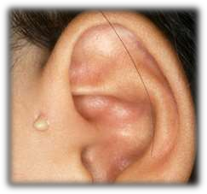
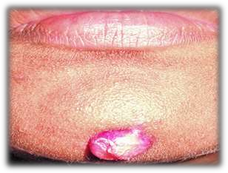
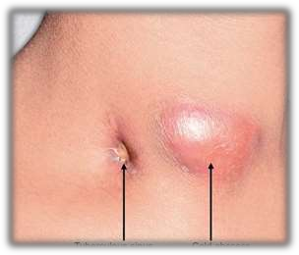
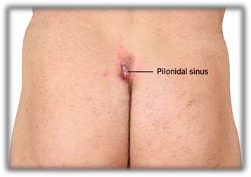

Slide 20
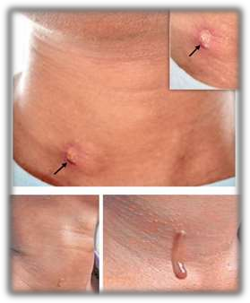
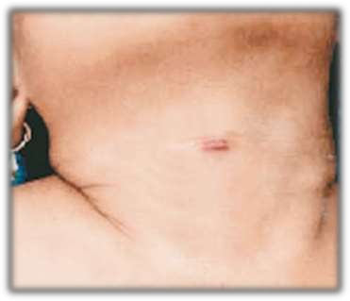
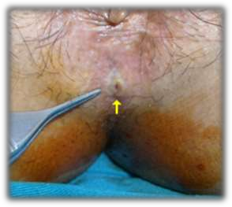
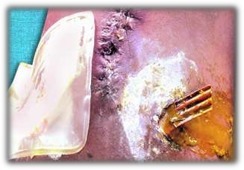

Slide 21
2. Number: usually single but multiple seen in HIV patients (or) actinomycosis.
Opening:
  sprouting with granulation tissue-foreign body.
  flushing with skin- TB
Surrounding area: erythematous- inflammatory bluish- TB
excoriated- faecal
pigmented- chronic sinus/fistulae.

Slide 22
Discharge:
  White thin caseous, cheesy like- TB sinus
  Faecal- faecal fistula
  Yellow sulphur granules- actinomycosis
  Bony granules- osteomyelitis
  Yellow purulent- staph. infections
  Thin mucous like- brachial fistula
  Saliva- parotid fistula

Slide 23
Palpation:
Temperature and tenderness:
Discharge: after application of pressure over the surrounding area.
Induration: present in chronic fistulae/sinus as in actinomycosis, OM
TB Sinus induration absent.
Fixity:
Palpation at deeper plane: lymph nodes- TB
Thickening of bone underneath- OM

Slide 24
INVESTIGATIONS
CBP- Hb, TLC, DLC, ESR.
Discharge for C/S , AFB, cytology, Gram staining.
X-RAY of the part to rule out OM, foreign body.
X-RAY KUB and USG abdomen in cases of lumbar fistula to rule out staghorn calculi.
MRI
BIOPSY from edge of sinus
CT Sinusogram

Slide 25
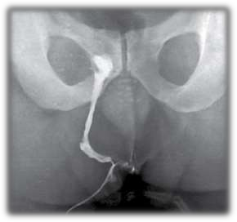
FISTULOGRAPHY/ SINUSOGRAPHY:
  For knowing the exact extent/origin of sinus (or)fistula.
  Water soluble or ultrafluid lipoidal iodine dye is used.
  Lipoidal iodine is poppy seed oil containing 40% iodine.

Slide 26
TREATMENT
BASIC PRINCIPLES:
Antibiotics
Adequate rest
Adequate excision
Adequate drainage.

Slide 27
After excision specimen SHOULD be sent for HPE.
Treating the cause. e.g., ATT for TB sinus.
removal of any foreign body. sequestrectomy for OM.

Slide 28
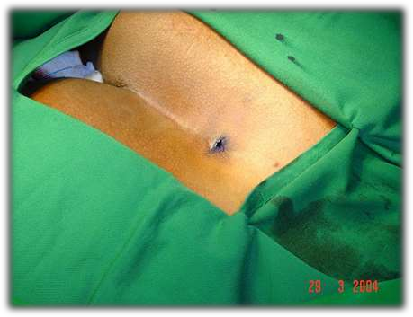
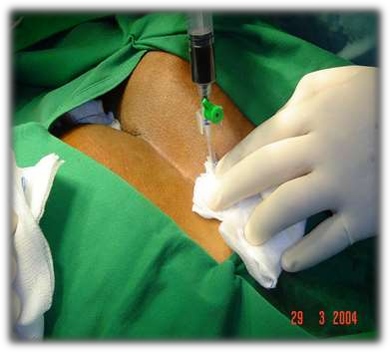
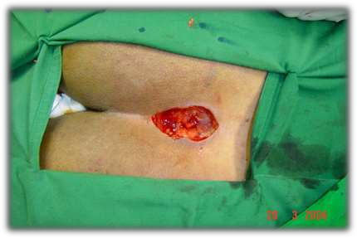

Slide 29
TUBERCULAR SINUS OF NECK
Causative organism: mostly M.tuberculosis
but also M.bovis Site and mode of infection:
lymph nodes in anterior triangle from tonsils.
lymph nodes in posterior triangle from adenoids.
supraclavicular nodes from apex of the lung.

Slide 30
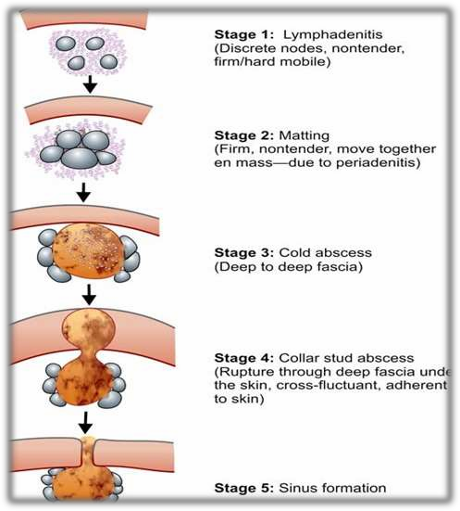
Clinical stages:

Slide 31
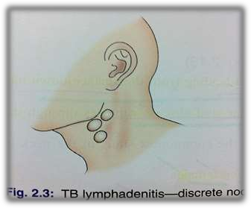
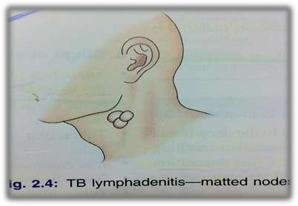
Stage of lymphadentis:
non-tender,discrete,mobile,firm lymph nodes
Stage of peridenitis:
due to involvement of capsule.
non-tender,MATTED,mobile together, firm
pathognomic of TB

Slide 32
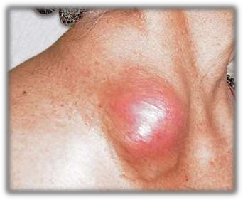
Stage of cold abscess:
due to caseating necrosis.
non-tender, cystic, fluctuant swelling not adherent to overlying skin.
Sternocleidomastoid contraction test- present deep to deep fascia
trans illumination negative

Slide 33
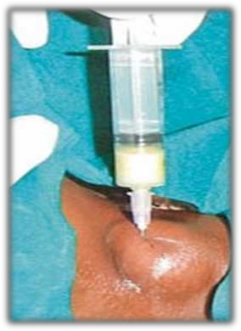
TREATMENT:
Zig-zag aspiration by wide bore needle in non- dependent area to avoid a persistent sinus.
Instillation of 1g streptomycin +/- INH in solution with closure of wound without placing a drain.
ATT
NOTE: I&D not done-persistent TB sinus.

Slide 34
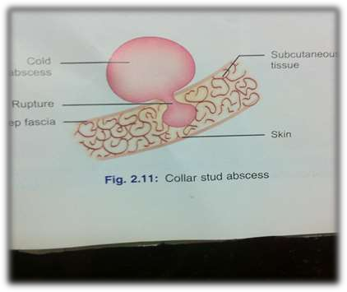
Stage of collar stud abscess:
cold abscess ruptures through deep fascia forming an another swelling in sub-cutaneous plane.
Fluctuant, adherent to skin.
Treated like a cold abscess.

Slide 35
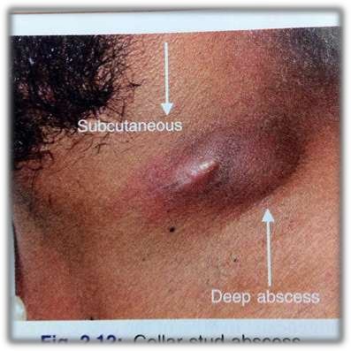
Collar stud abscess

Slide 36
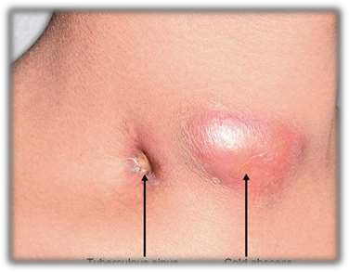
Stage of sinus:
collar stud abscess bursts out leading to a persistent discharging sinus.
Can be multiple, wide opening, undermined edges, non-mobile.
Bluish discoloration around the edges.
NO INDURATION.

Slide 37
INVESTIGATIONS
Hematocrit, ESR , S.albumin , S.globulin
FNAC of lymph nodes and smear for AFB and C/S
Open node biopsy of lymph nodes.
Edge biopsy of sinus- granuloma.
mantoux test
Chest X ray
Sputum for AFB

Slide 38
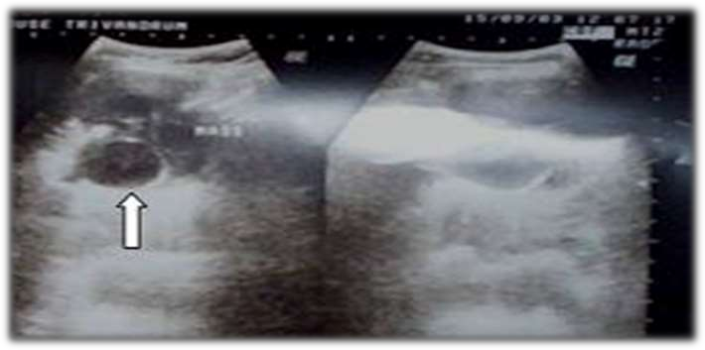
Sometimes, USG neck to detect cold abscess.
Hypoechoeic lesions with internal echoes S/O debris within.
Guided aspiration of cold abscess.

Slide 39
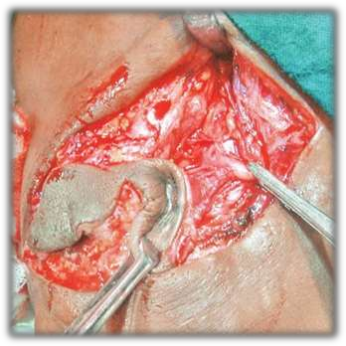
TREATMENT
ATT
Excision of sinus tract with excision of diseased lymph nodes.

Slide 40
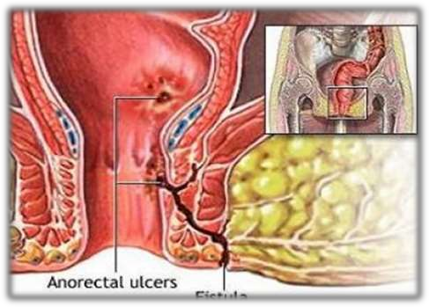
FISTULA-IN-ANO
Chronic abnormal communication usually lined to some degree by granulation tissue, which runs outwards from anorectal lumen (internal opening) to skin of perineum or the buttocks (external opening)

Slide 41
AETIOPATHOGENESIS
Cryptoglandular (90% cases)
Non cryptoglandular (10% cases) TB
Diabetes mellitus
Crohn’s disease Carcinoma rectum Trauma
Lymphogranuloma venereum Radiotherapy
Immunocompromised patients (HIV etc.,)

Slide 42
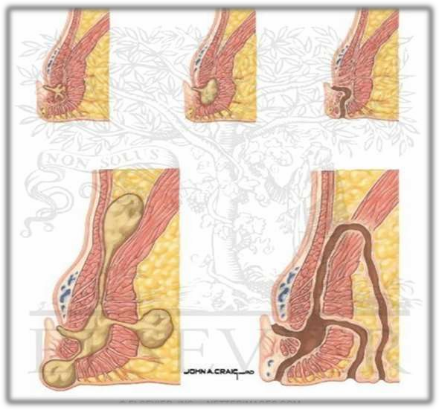
CRYPTOGLANDULAR HYPOTHESIS

Slide 43
CLASSIFICATION
PARK’S CLASSIFICATION:
(relation of primary tract to external sphincter)
Inter sphincteric (45%)
Trans sphincteric (40%)
Supra sphincteric
Extra sphincteric

Slide 44


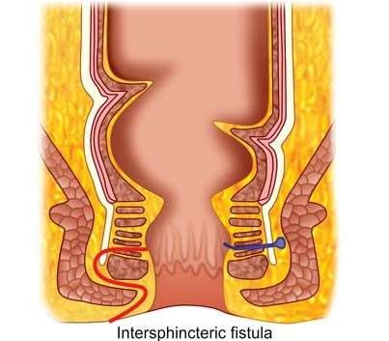
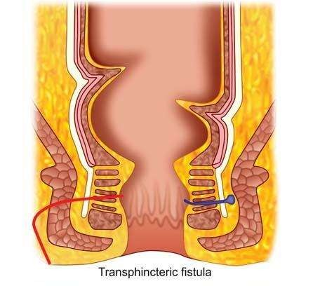


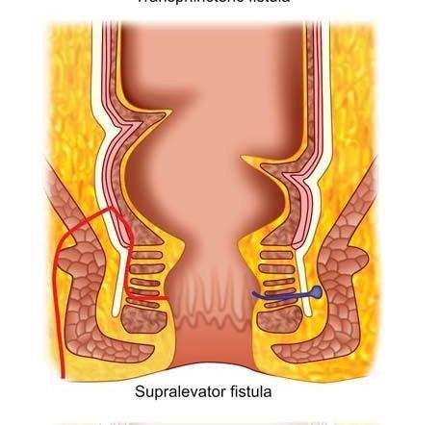
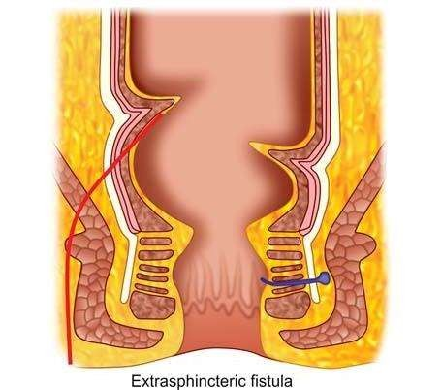

Slide 45
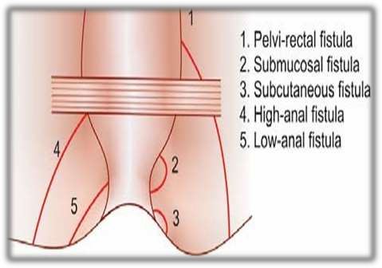
STANDARD CLASSIFICATION
Sub cutaneous
Sub mucous
Low anal
High anal
Pelvi rectal

Slide 46
Can be
low level fistula- open into anal canal below
the internal ring.
high level fistula- at/ above the internal ring.
Can be
Simple- without any extensions Complex- with extensions
Can be
single
multiple- TB, ulcerative colitis, crohn’s, HIV, LGV

Slide 47
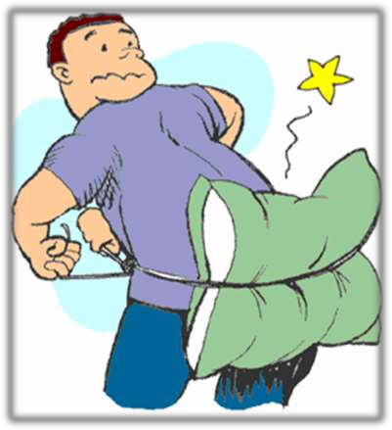
CLINICAL PRESENTATION
Intermittent discharge
(sero-purulent/ bloody)
Pain
(which increases until temporary relief occurs when pus discharges)
Pruritus ani
Previous h/o anal gland infection

Slide 48
CLINICAL ASSESMENT
HISTORY: full medical history incl. obstetric,anal, gastrointestinal, surgical, continence
DRE: area of induration, fibrous tract and internal opening may be felt (“button-hole” defect in
Ca rectum)
PROCTOSIGMOIDOSCOPY:
To evaluate rectal mucosa for any underlying disease process.

Slide 49
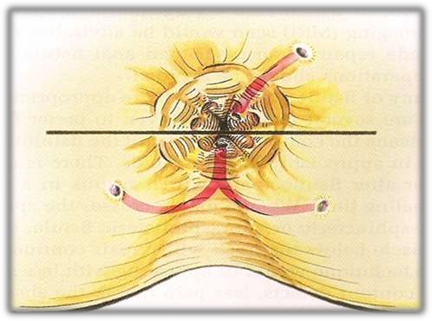
GOODSALL’S RULE
If external opening in anterior half of anus, fistula usually runs directly into anal canal.
If external opening in posterior half of anus, fistula usually curves midline of the anal canal posteriorly.

Slide 50
IMAGING
Fistulography
Endoanal ultrasound
MRI

Slide 51
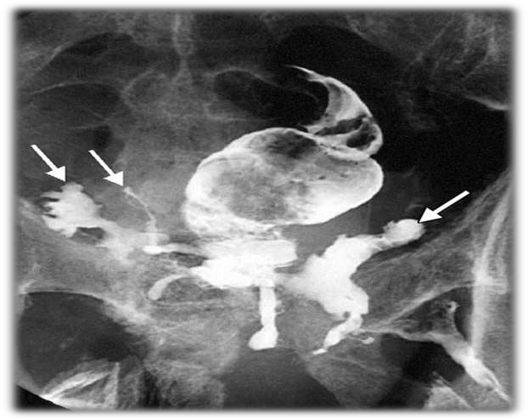
Fistulography:
Reveals primary and secondary tracts.
Useful if extra sphincteric fistula
suspected.

Slide 52
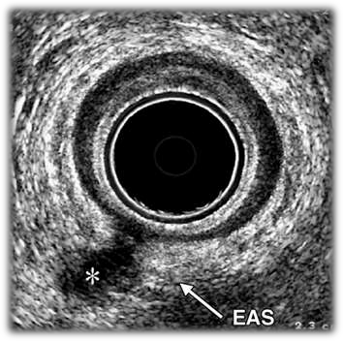
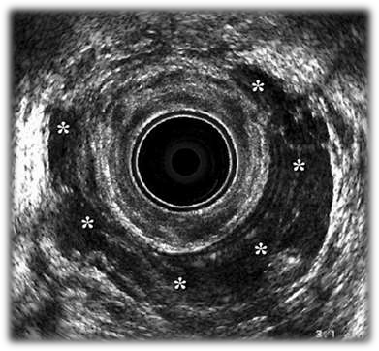
END0 ANAL ULTRASOUND
Determines sphincter integrity.
Complexity of fistula.
horse-shoe fistula

Slide 53
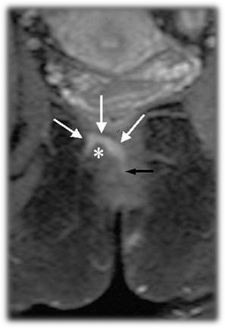
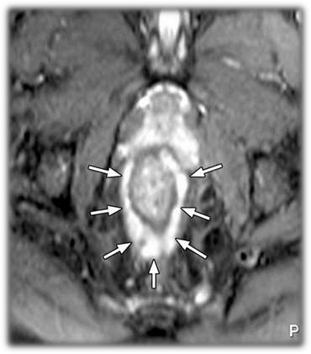
MRI
“GOLD STANDARD” for fistula-in-ano imaging.
high variety supra sphincteric fistula.
horse-shoe fistula.

Slide 54
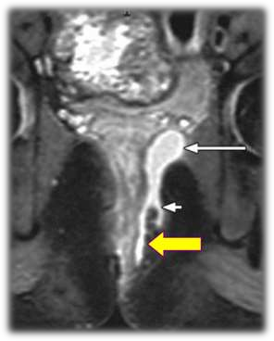
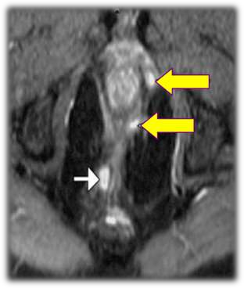
MRI
Abscesses and extensions
contralateral disease

Slide 55
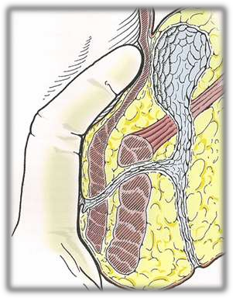
PRINCIPLES OF TREATMENT
Control sepsis
EUA
Laying open abscesses and secondary tracts Adequate drainage – seton insertion
Define anatomy
  Openings and tracts
    Internal and External
    Single –v- multiple
    Extensions / Horseshoe
  Relation to sphincter complex
    High –v- Low
Exclude co-existent disease

Slide 56
SURGICAL MANAGEMENT
Fistulotomy (The laying open technique)
Fistulectomy
Seton techniques
Fibrin glue
Anal fistula plug
Advancement flap
LIFT procedure.
sphincter preserving techniques.

Slide 57
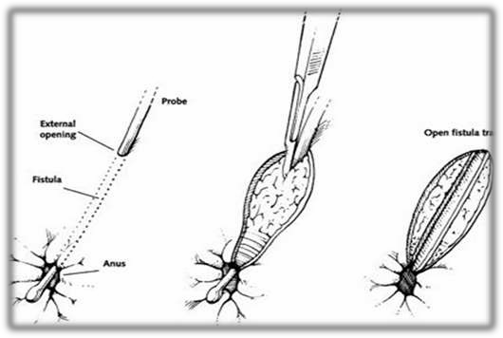
FISTULOTOMY
In inter-sphincteric and low trans-sphincteric fistulas.
Identification of tract with probe followed by division of all structures between external and internal openings.
Secondary tracts laid open.
▪ +/- marsupialization.

Slide 58
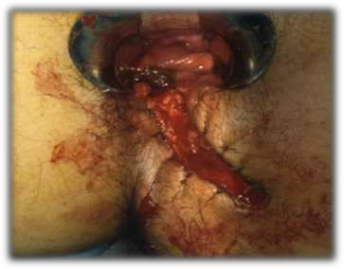
Advantages
least chance of recurrence relatively easy procedure minor degree of incontinence.
Risks
results in large and deep wounds that might take months to heal.

Slide 59
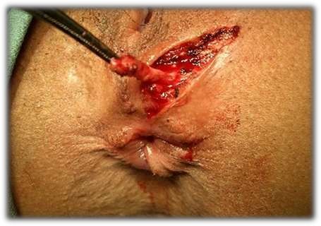
FISTULECTOMY
All chronic (low) and also for posterior horse-shoe shaped fistulas.
Excision of entire fibrous tissue and tract and wound kept open.
Sphincter repair +/- advancement flap.
High anal fistulas
+/-colostomy.

Slide 60
SETON SUTURE PLACEMENT
Preferable surgical option for high variety.
Setons are usually made from rubber slings
2 types of seton suture can be placed
Draining Seton
Facilitates draining of sepsis
Left loose and allows fistula to heal by fibrosis
Cutting Seto
Slowly "cheese-wires" though the sphincter muscle Allows fibrosis to take place behind as it gradually
cuts through

Slide 61



Slide 62
FIBRIN GLUE
Multi component system containing mainly human plasma fibrinogen and thrombin.
Injected into fistula track which hardens in few minutes and fills the track.

Slide 63
ANAL FISTULA PLUG
The Anal fistula plug is a minimally invasive and sphincter-preserving alternative to traditional fistula surgery.
The plug is a conical device and is placed by drawing it through the fistula tract and suturing it in place.
the plug, once implanted, incorporates naturally over time into the human tissue (human cells and tissues will 'grow' into the plug), thus facilitating the closure of the fistula.

Slide 64



FISTULA PLUG

Slide 65





FISTULA PLUG:

Slide 66



ADVANCEMENT FLAPS
Endorectal
Fistula tract probed
Flap raised
  Mucosa + Int. Sphincter
Internal opening excised/closed
Flap advanced & sutured

Slide 67


ADVANCEMENT FLAP
Anodermal
Fistula tract probed
Flap raised
  Anodermal
Flap advanced & sutures
External defect closed

Slide 68

LIFT PROCEDURE
Ligation of Inter sphincteric Fistula Tract
Trans sphincteric fistula
Draining seton – 6 weeks
Tract prepared with fistula brush
  Debrides
  De-epithelializes

Slide 69
FOLLOW UP
As with most anorectal disorders, follow-up care includes:
Perianal baths,
analgesics for pain,
stool bulking agents, and
good perianal hygiene

Slide 70


